Slide 1



Neelanjans Game Report Dashboard
View in Power BI
Last data refresh:
6/23/2023 1:09:16 AM UTC
Downloaded at:
6/23/2023 4:49:17 PM UTC

Slide 2
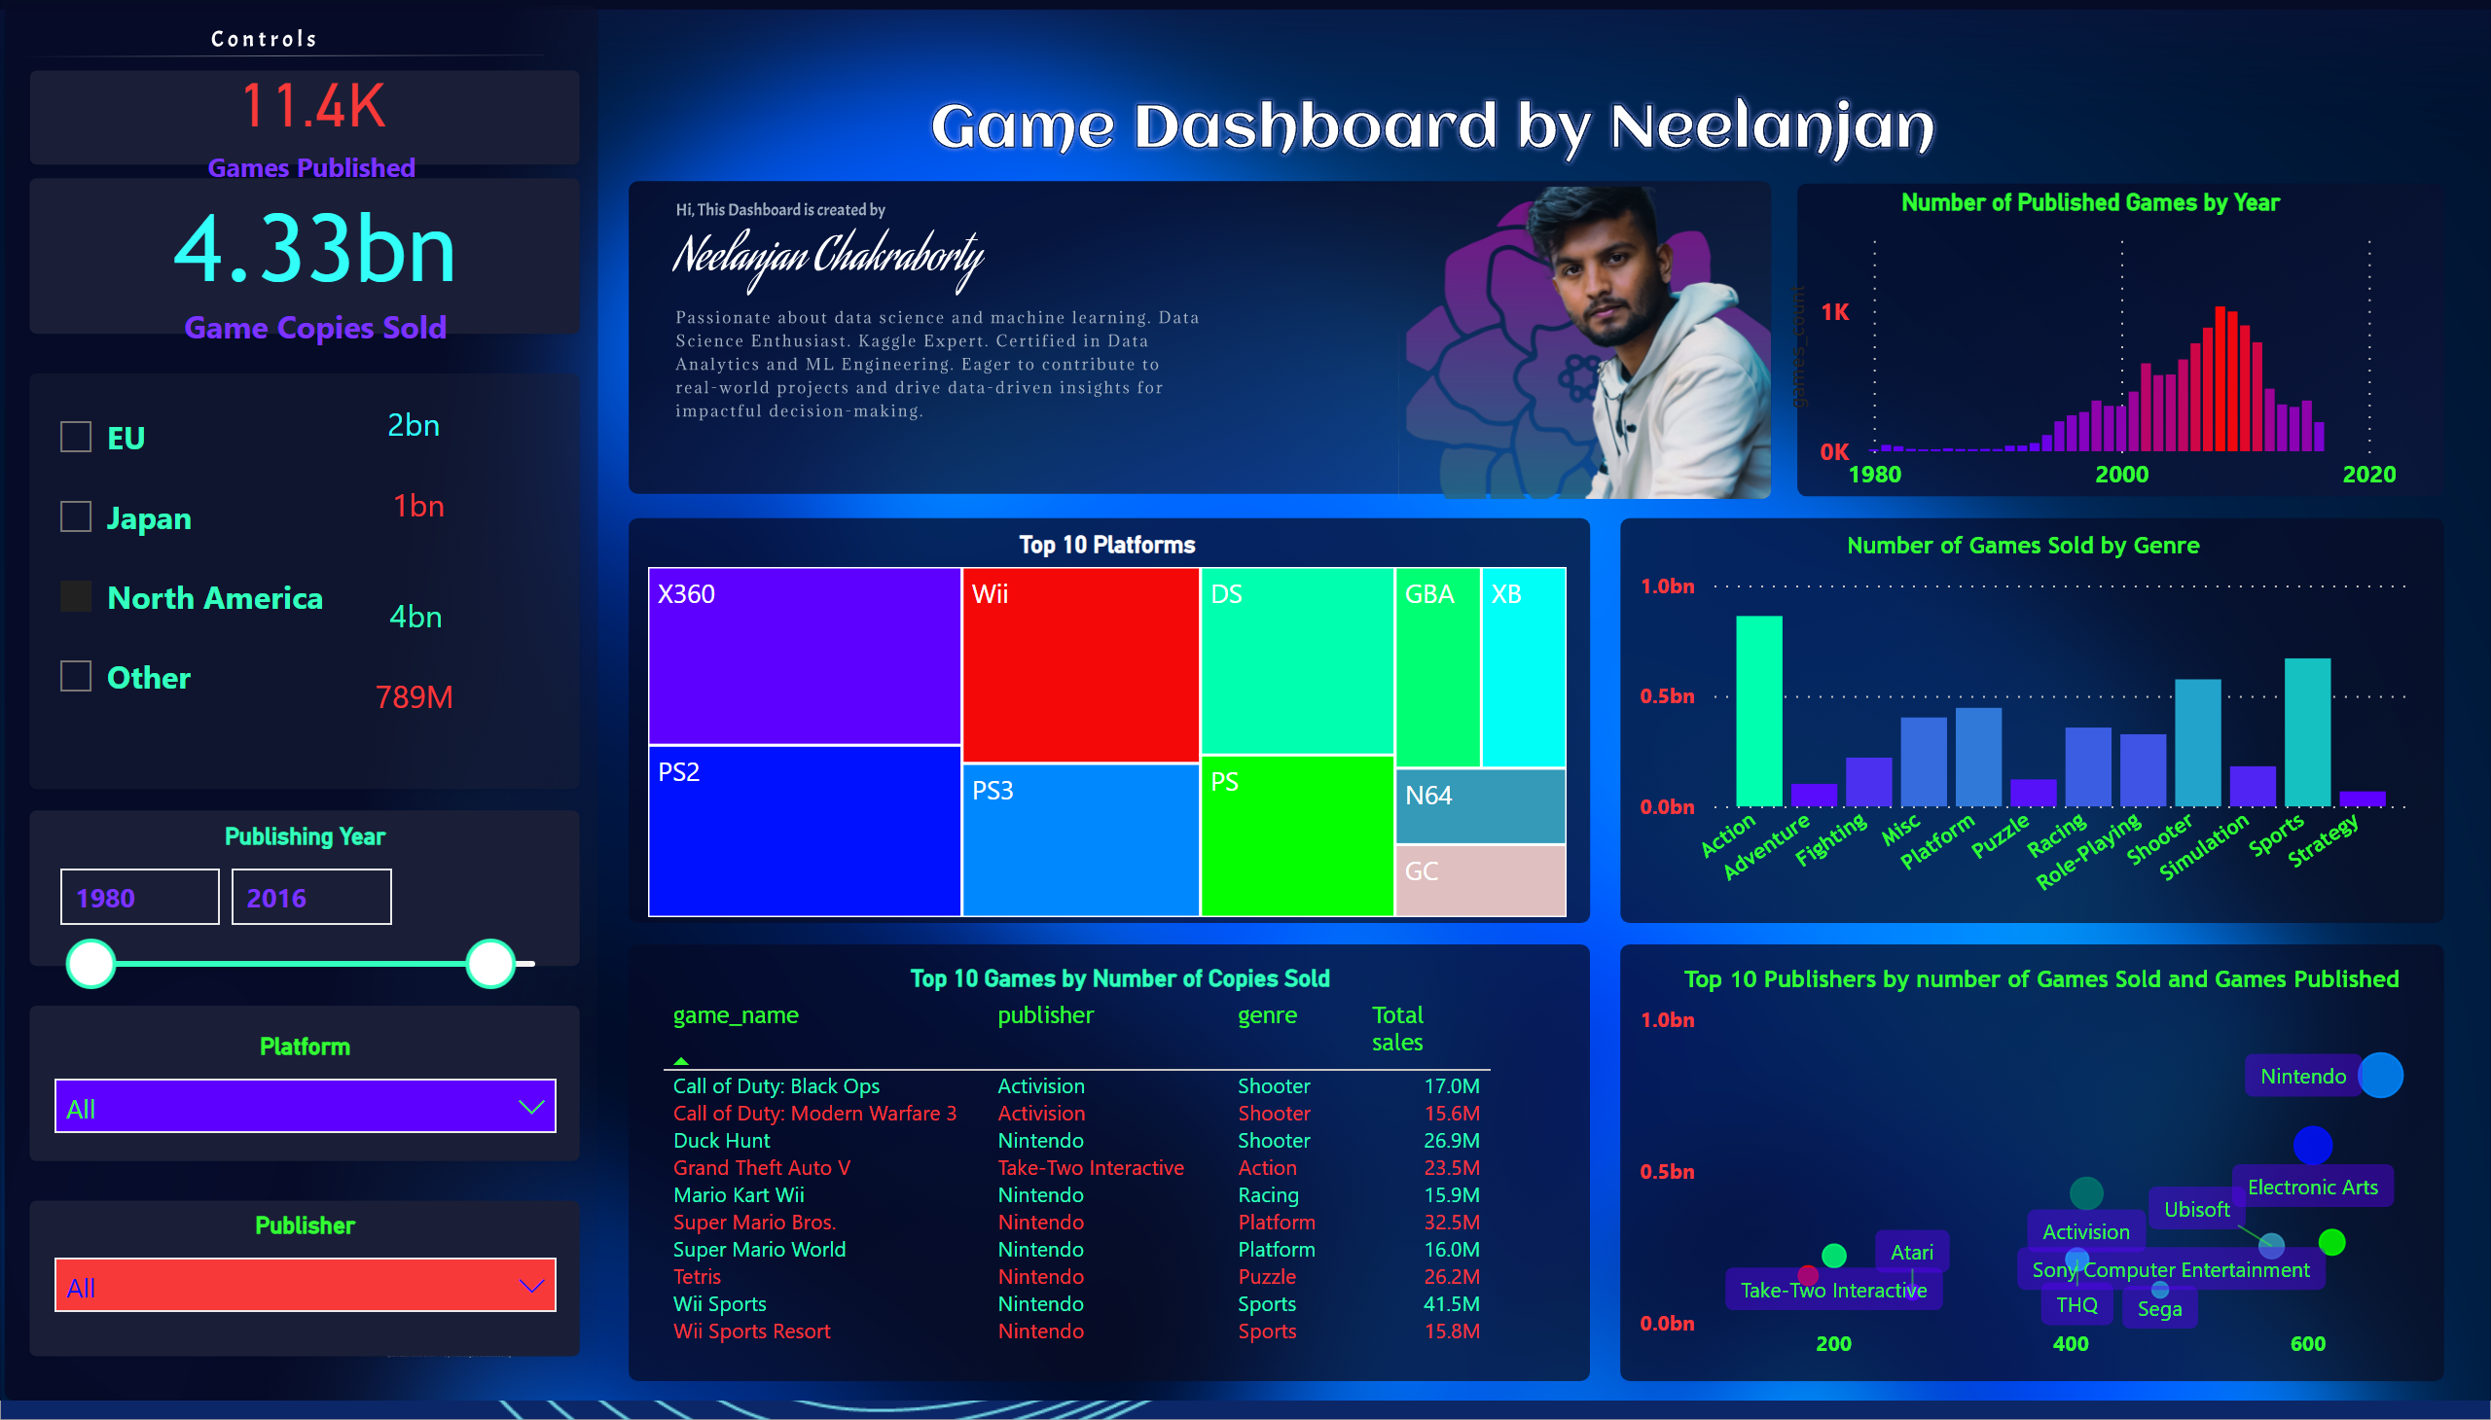
VG_Sales
Notes:
Number of Games Sold by Genre
No alt text provided
Publisher
No alt text provided
card
No alt text provided
Top 10 Platforms
No alt text provided
Number of Published Games by Year
No alt text provided
Top 10 Games by Number of Copies Sold
No alt text provided
Publishing Year
No alt text provided
Top 10 Publishers by number of Games Sold and Games Published
No alt text provided
Platform
No alt text provided
card
No alt text provided
slicer
No alt text provided
card
No alt text provided
card
No alt text provided
card
No alt text provided
card
No alt text provided

